Slide 1




A
NEXT GEN EMPLOYABILITY PROGRAM
Creating a future-ready workforce
Team Members
College Name
Arunachala College of Engineering
for Women
Student Name:Afrin Shehna D
Student ID : au960221104010

Slide 2

CAPSTONE PROJECT SHOWCASE
Project Title
Car Rentals Application with Django Framework
Abstract | Problem Statement | Project Overview | Proposed Solution | Technology Used | Modelling & Results | Conclusion

Slide 3
Abstract
This study outlines the development of a car rental web application using Django.
Key features include user authentication, car listing with detailed specifications, search and filtering options, booking management, payment integration, user profiles, and an admin panel.
The application follows the MVC architecture pattern and utilizes Django's features for efficient development.
Responsive design principles ensure usability across devices, and rigorous testing ensures functionality, security, and performance.
Overall, the web application provides a user-friendly, secure, and scalable solution for online car rental services.
Source :

Slide 4
Problem Statement
Traditional car rental processes are often cumbersome and time-consuming, involving manual paperwork and
in-person transactions.
Lack of a centralized online platform results in inefficiencies, such as limited access to car availability and
difficulty in comparing options.
Existing online car rental platforms may lack user-friendly interfaces, robust security measures, and efficient
booking and payment systems.
Without proper management tools, car rental businesses struggle to effectively organize and track bookings,
manage inventory, and handle customer interactions.
The absence of a comprehensive solution leads to a fragmented and inefficient car rental experience for both
customers and rental businesses.
Source :

Slide 5
Project Overview
The project aims to develop a car rental web application using the Django framework.
It will provide users with a convenient platform to rent cars online, streamlining the rental process.
Key features include user authentication, car listing with detailed information, search and filtering
options, booking management, payment integration, user profiles, and an admin panel.
The application will follow the MVC architecture pattern, leveraging Django's built-in features for
efficient development.
Responsive design principles will be implemented to ensure usability across various devices.
Rigorous testing will be conducted to ensure functionality, security, and performance.
The goal is to deliver a user-friendly, secure, and scalable solution for online car rental services.
Source :

Slide 6
Proposed Solution
Develop a user-friendly web application using the Django framework to facilitate car rentals.
Implement a secure user authentication system to allow users to register, login, and manage their
accounts securely.
Create a comprehensive database of car listings with detailed specifications, including make, model, year,
price, and availability.
Incorporate search and filtering functionalities to enable users to easily find cars based on their preferences
such as location, price range, and car features.
Implement a robust booking management system to allow users to book cars for specific dates and times,
with features like reservation management to prevent double bookings
Integrate secure payment gateways to enable online payments for bookings, ensuring the safety of financial
transactions.
Develop user profiles for users to manage their personal information, view booking history, and update
preferences.
Create an admin panel with tools to manage car listings, user accounts, bookings, and payments efficiently.
Source :

Slide 7


Technology Used
Front-end
Back-end
Source :

Slide 8
Modelling & Results
Modeling:
User Model:stores user information for registration and authentication.
Car Model: Contains details of each car such as make, model, year, price, and availability.
Booking Model:Links users with their booked cars and includes rental dates.
Results:
Developed a fully functional car rental web application using Django.
Implemented user authentication, allowing users to register, log in, and manage their bookings.
Created a catalog of available cars with detailed information for users to browse and select.
Implemented a booking system for users to reserve cars for specific rental dates.
Developed an admin dashboard for administrators to manage cars, bookings, and user accounts.
Source :

Slide 9
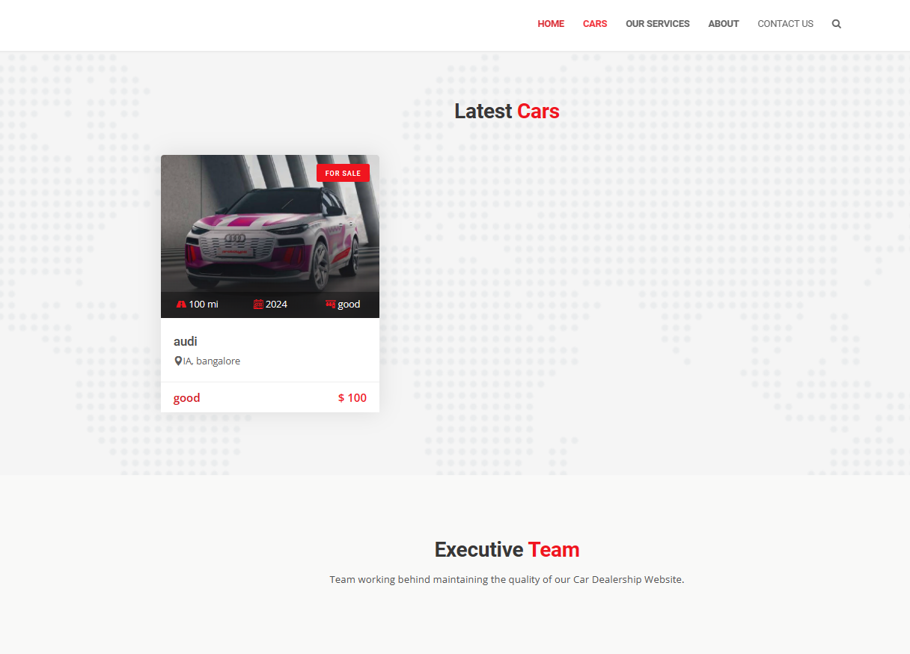
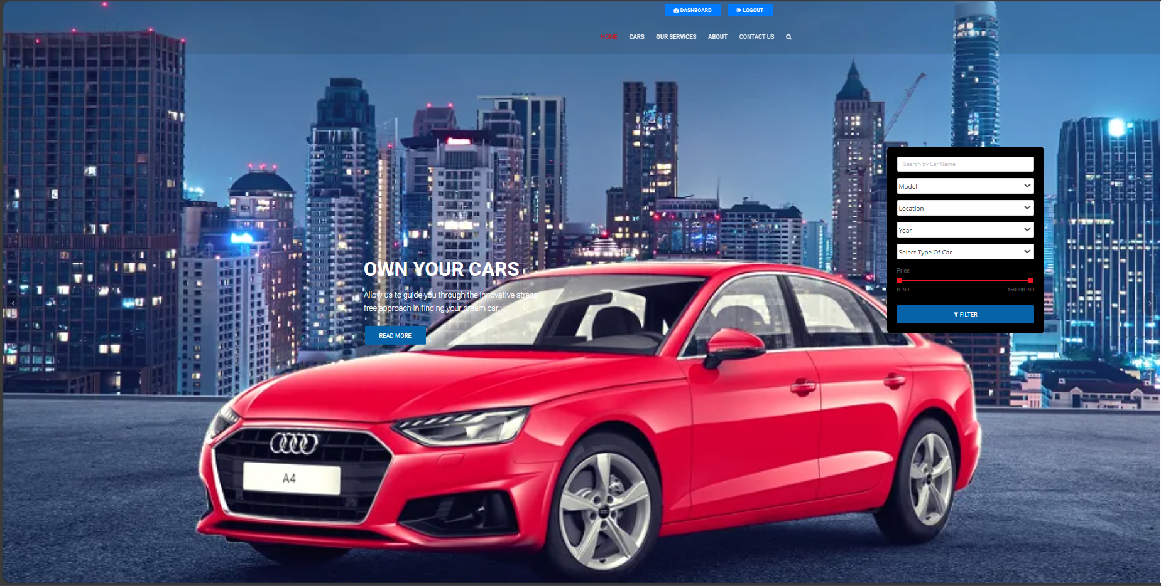
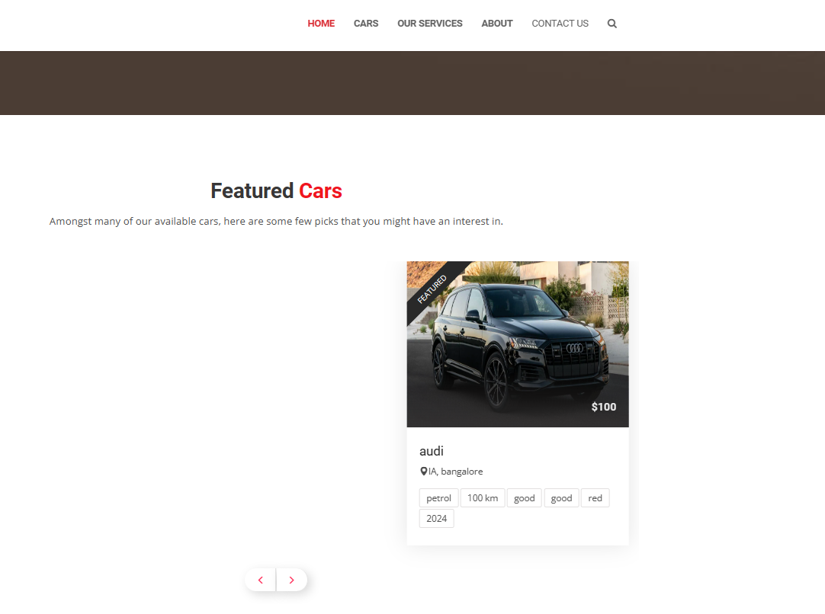
Homepage

Slide 10
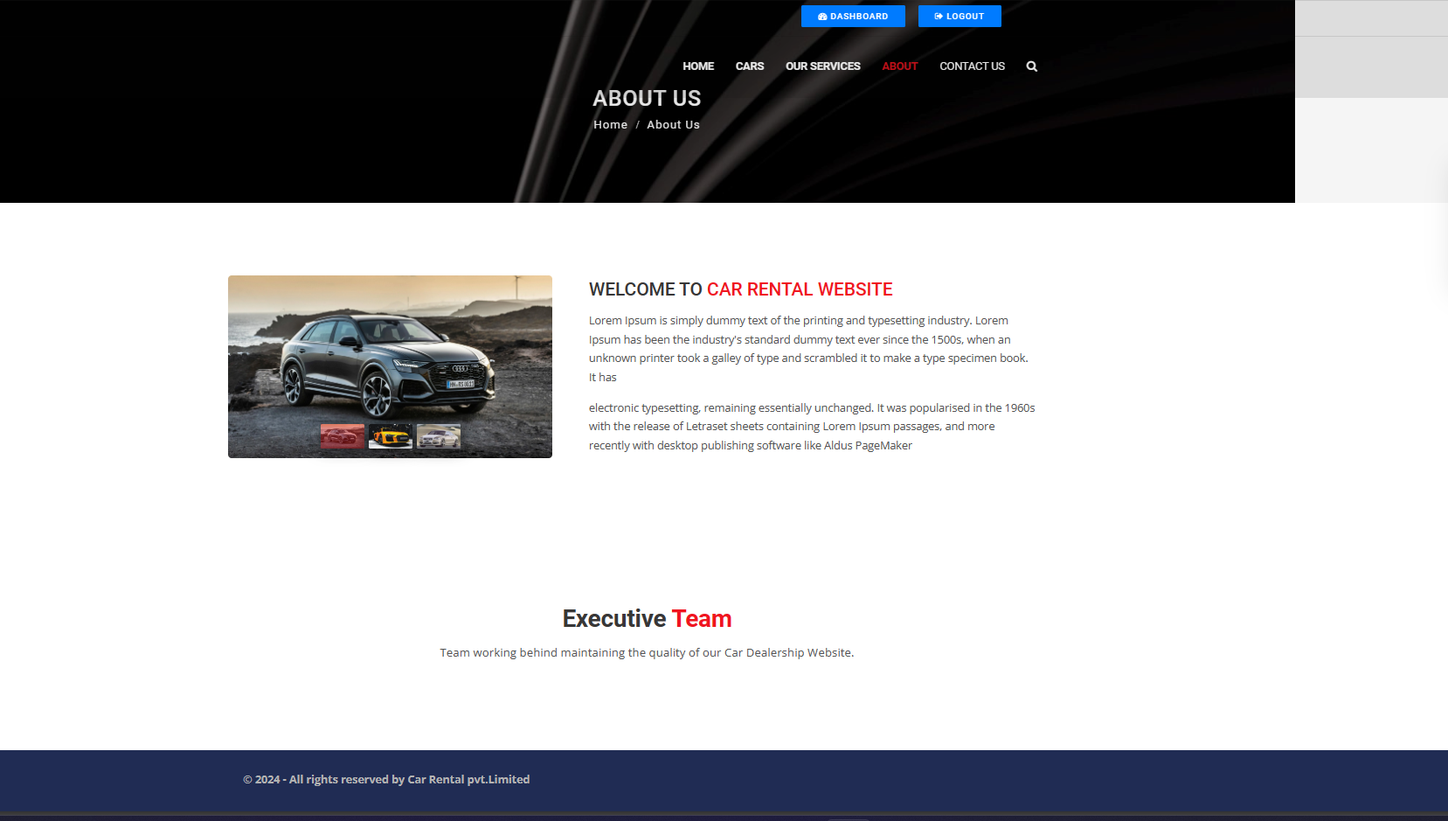
About-Us-Page

Slide 11
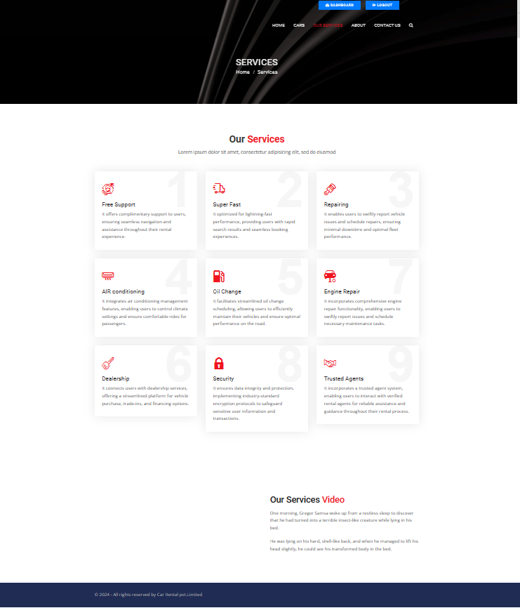
Service-Page

Slide 12
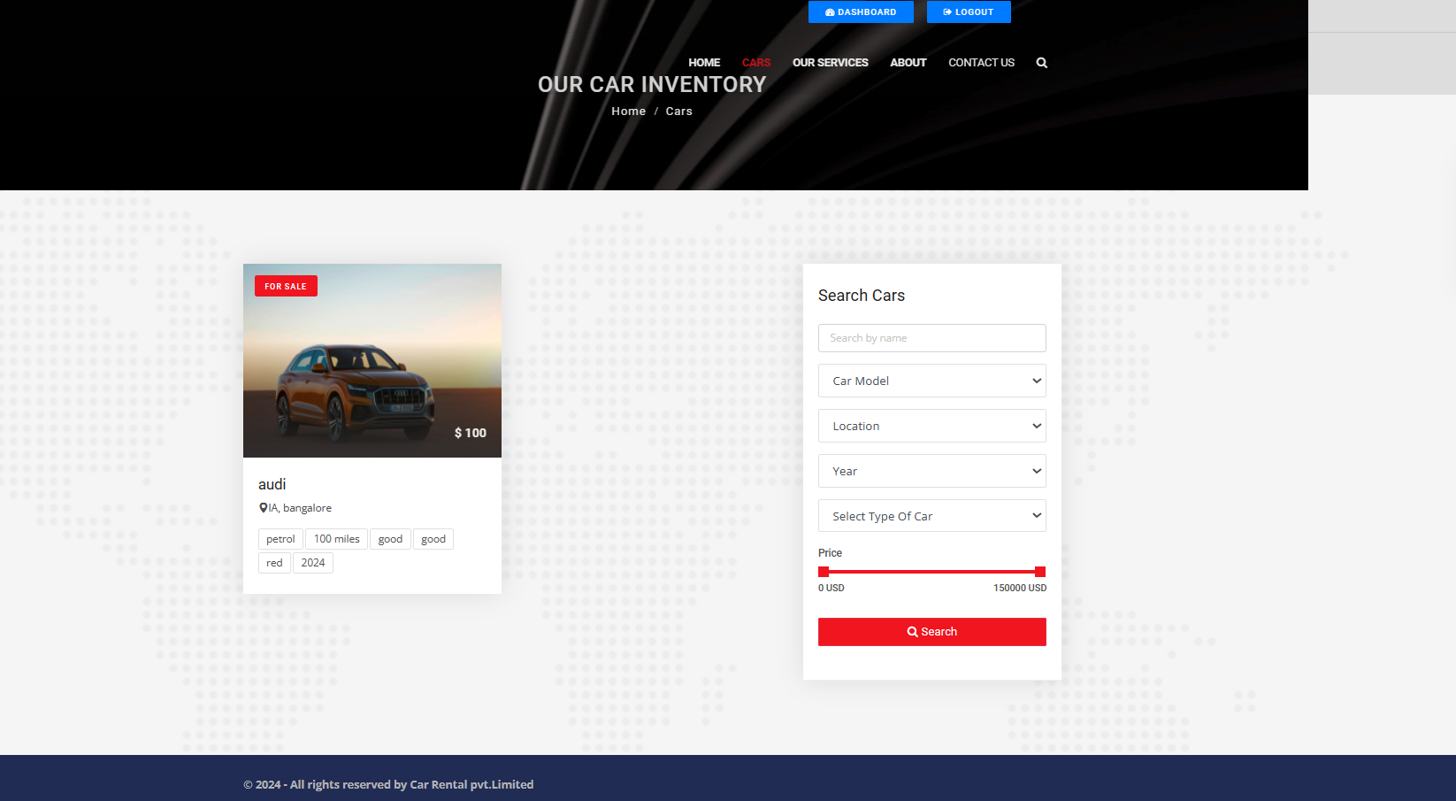
Cars-Page

Slide 13
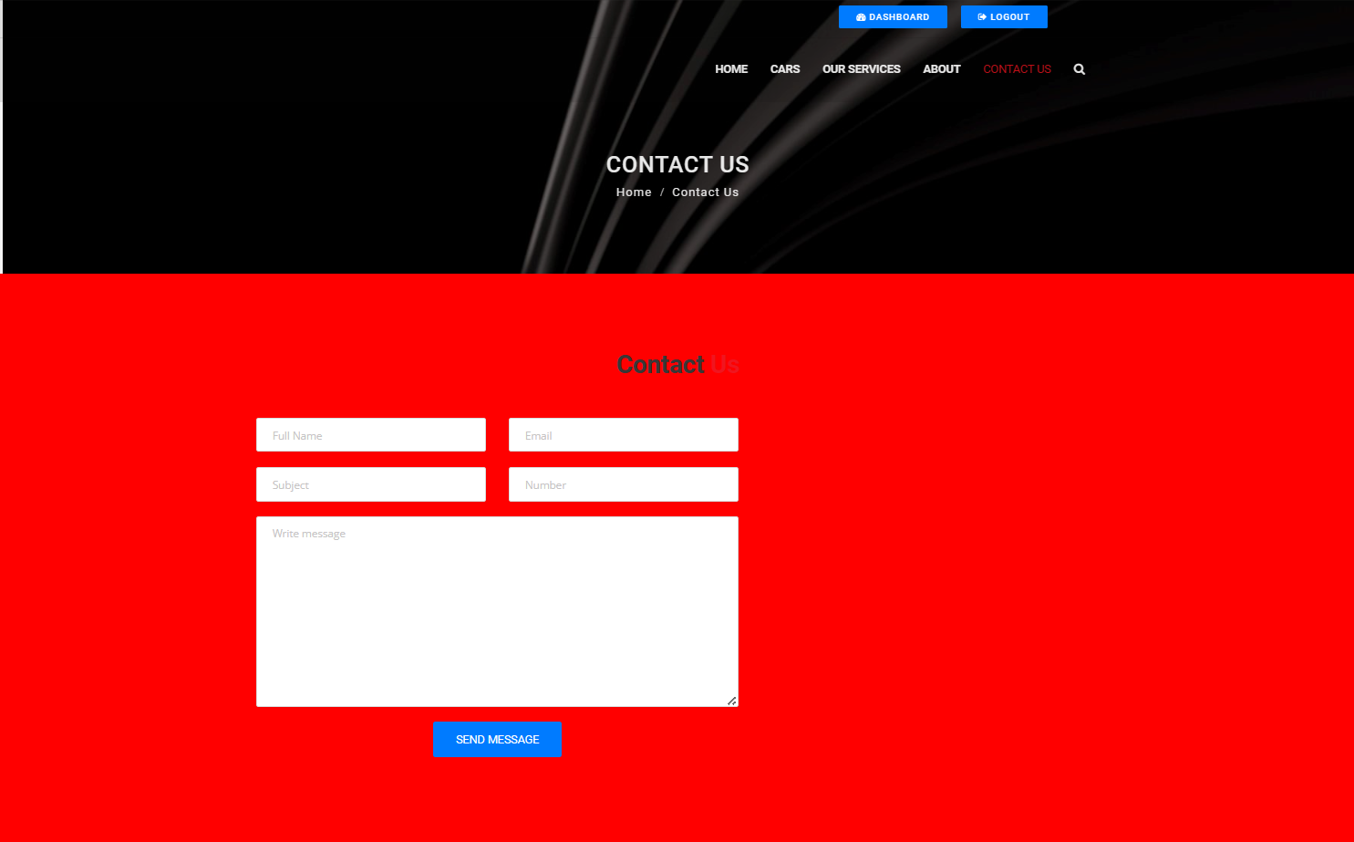
Contact Us-Page

Slide 14
Future Enhancements:
User Reviews and Ratings: Allow users to leave reviews and ratings for rental cars.
In-App Messaging System: Implement an in-app messaging system for user-provider communication.
Flexible Booking Options: Introduce hourly rentals or long-term leases for greater flexibility.
Vehicle Customization: Offer options for users to select preferred car features.
Integration with Navigation Apps: Seamlessly integrate with popular navigation apps for user convenience.

Slide 15
Conclusion
The development of a car rental web application using Django offers a
streamlined and user-friendly platform for renting cars online.
Moving forward, continual improvements and enhancements, such as user
reviews, flexible booking options, and integration with navigation apps, will further
enhance the application's functionality and user experience cementing its position
as a leading solution in the car rental industry.
By leveraging Django's powerful framework and adhering to best practices in
web development, the application ensures scalability, reliability, and performance.
Source :

Slide 16
Thank You!
Notes:
Thank You !!

